Slide 1




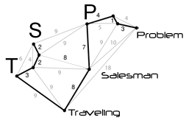
TUNISIAN REPUBLIC MINISTRY OF HIGHER EDUCTION AND SCIENTIFIC RESEARCH UNIVERSITY OF SOUSSE
Higher Institute of Management of Sousse
The Traveling Salesman Problem
Concepts, Challenges, and Solutions
Course
Algorithm genius
Presented By
Chaouch Houssem Eddine
Academic Year 2025-2026
Notes:
Hello everyone,Today I’ll present the Travelling Salesman Problem — a famous optimization challenge where the goal is to find the shortest route that visits each city once and returns to the start. Let’s dive in!"

Slide 2
Presentation plan
Introduction
TSP Classe complexity
1
7
Graph Theory Basics
TSP complexity
TSP Problem
Real-World Applications
2
8
Problem Statement
TSP
Related Concepts
Brute Force Approach for TSP
3
9
TSP and Graph Path Concepts
Analysis for Brute Force TSP
Mathematical Formulation
TSP Variants and Extensions
4
10
Understanding the TSP Equation
Exploring the Many Faces of the Problem
TSP Example
Future Directions and Challenges
5
11
Touring the Sahel
Research Directions and Open Challenges
Complexity classes
Conclusion
6
12
Understanding Computational Complexity
Conclusion TSP

Slide 3
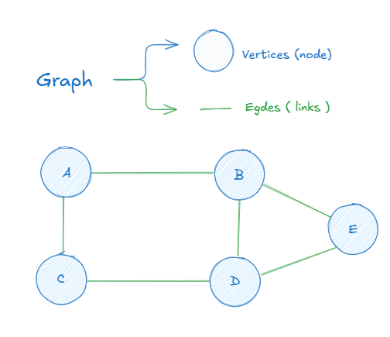
1
Introduction to Graph Theory Basics
What is a Graph?
A graph is a mathematical structure used to model pairwise relations between objects. It is made up of:
Vertices (nodes): These represent entities or locations.
Edges (links): represent paths or roads between vertices.
1
Notes:
The main goal of a graph is to represent and analyze relationships or connections between elements. This allows us to:
Model real-world systems like transportation networks, social networks, or the internet,
Find optimal paths (shortest, cheapest, fastest),
Detect patterns, such as cycles, clusters, or bottlenecks,
Solve complex problems in computer science, AI, logistics, and more.

Slide 4
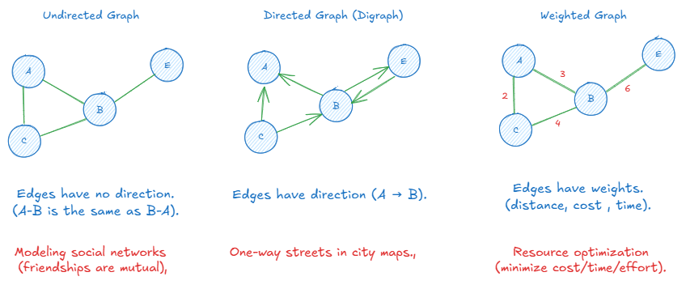
1
Introduction to Graph Theory Basics
Types of Graphs
There are different types of graphs, depending on how the edges behave and what they represent
2

Slide 5
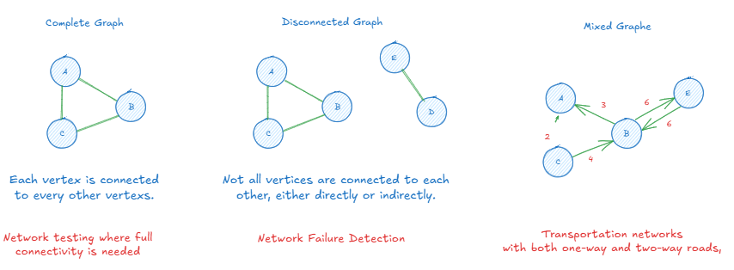
1
Introduction to Graph Theory Basics
Types of Graphs
There are different types of graphs, depending on how the edges behave and what they represent
3

Slide 6
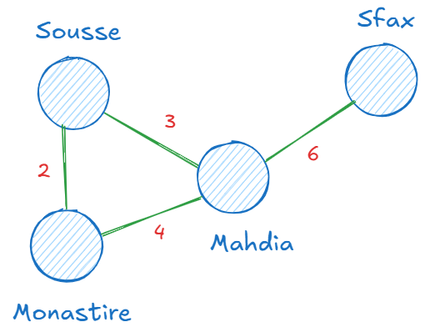
1
Introduction to Graph Theory Basics
Real-Life Analogy:
To better understand graphs, think of a GPS map:
Cities are the vertices (nodes)
Roads connecting the cities are the edges,
The distance or travel time on each road represents the weights.
4

Slide 7
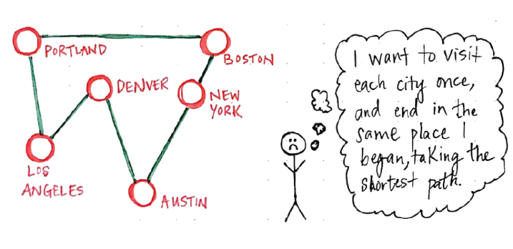
2
What is the Traveling Salesman Problem (TSP)
Problem Statement
A salesman needs to visit a list of cities exactly once.He must plan the most efficient route between them.In the end, he must return to his starting city
5

Slide 8
2
What is the Traveling Salesman Problem (TSP)
Objective
Minimize total travel distance/cost/time.
Visit every city exactly once.
Return to the starting point.
6

Slide 9
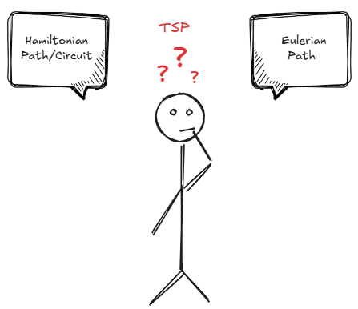
3
Related Concepts
TSP and Graph Path Concepts
To understand the Traveling Salesman Problem (TSP), let’s look at key concepts: Hamiltonian Paths, Hamiltonian Circuits, and Eulerian Paths, which involve visiting vertices or edges in a graph. TSP builds on these ideas with optimization.
7

Slide 10
3
Related Concepts
TSP and Graph Path Concept Hamiltonian Path
A Hamiltonian path or traceable path is a path that visits each vertex of the graph exactly once, and doesn’t require returning to the start.
A connected graph with sufficient edges between vertices can have a Hamiltonian Path.
No isolated vertices: All vertices must have at least one connection.
8

Slide 11
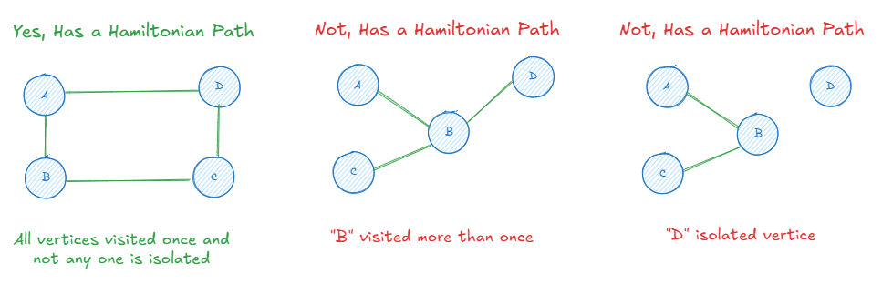
3
Related Concepts
TSP and Graph Path Concept Hamiltonian Path
How to tell if a graph has a Hamiltonian Path ?
9

Slide 12
3
Related Concepts
TSP and Graph Path Concept Hamiltonian Path
Which Graphs Can Have Hamiltonian Path ?
Can Have
Cannot Have
Complete graphs
Sparse graphs
Disconnected graphs
Graphs with isolated vertices.
10
Notes:
Sparse graphs
A graph in which the number of edges is much less than the possible number of edges.

Slide 13
3
Related Concepts
TSP and Graph Path Concept Hamiltonian Circuit
A Hamiltonian Path that returns to the starting vertice, forming a closed loop.
The graph must be connected.
There must be a cyclic traversal of all vertices where each vertex is visited exactly once and the final vertex connects back to the starting point.
11

Slide 14
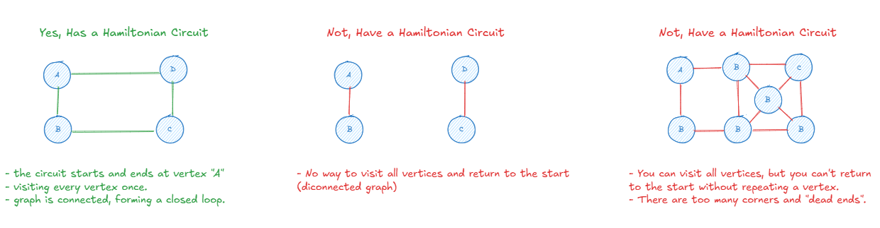
3
Related Concepts
TSP and Graph Path Concept Hamiltonian Circuit
How to tell if a graph has a Hamiltonian Circuit?
12

Slide 15
3
Related Concepts
TSP and Graph Path Concept Hamiltonian Circuit
Which Graphs Can Have Hamiltonian Circuit ?
Can Have
Cannot Have
Complete graphs
Cyclic graphs
Disconnected graphs
Graphs that do not form a cycle
13
Notes:
Sparse graphs
A graph in which the number of edges is much less than the possible number of edges.

Slide 16
3
Related Concepts
TSP and Graph Path Concept Eulerian Path (Undirected Graph)
Eulerian Path is a path in a graph that visits every edge exactly once.
Visits each edge exactly once.
The start and end vertices can be different.
Unnecessarily to visiting all vertices.
14

Slide 17
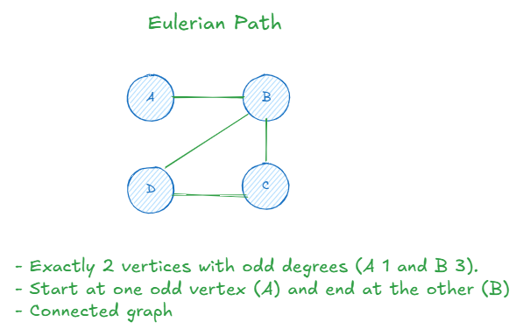
3
Related Concepts
TSP and Graph Path Concept Eulerian Path (Undirected Graph)
Condition Eulerian Path :
The graph must be connected.
0 or 2 vertices with odd degree.
15
Notes:
(all vertices are reachable from one another).

Slide 18
3
Related Concepts
TSP and Graph Path Concept Eulerian Circuit (Undirected Graph)
Eulerian Circuit it’s special type of Eulerian Path.
Visits every edge exactly once and returns to the starting vertex.
The start and end vertices are the same.
16

Slide 19
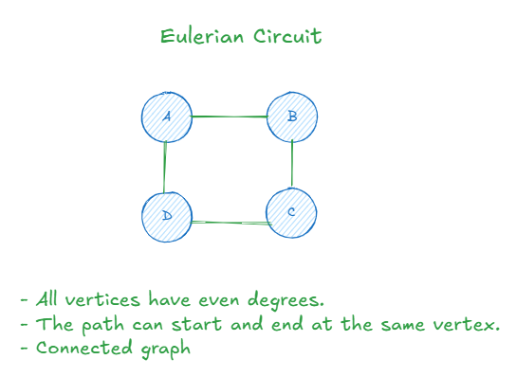
3
Related Concepts
TSP and Graph Path Concept Eulerian Circuit (Undirected Graph)
Condition Circuit (closed loop) :
The graph must be connected.
All vertices must have an even degree.
17
Notes:
(all vertices are reachable from one another).
o Eulerian Path>2Connected❌ No❌ No

Slide 20

3
Revisiting the Traveling Salesman Problem
Questioning the Problem
Now that we've explored different types of paths and circuits... what kind of path does the TSP actually require?
Think carefully
We need to visit every city once,
And return to where we started,
While also minimizing the total travel cost...
18

Slide 21
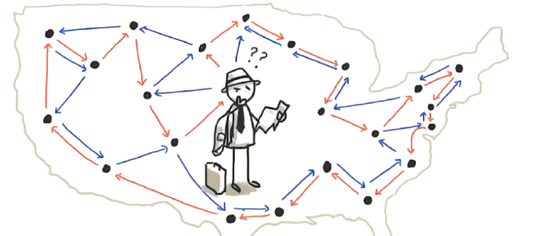
3
TSP - A Hamiltonian Circuit with a Twist
Answer
TSP is based on a Hamiltonian Circuit.
It’s a closed path that visits each vertex (city) exactly once and returns to the starting point.
But unlike a standard Hamiltonian circuit, TSP adds
Edge Weights (costs, distances, time)
Optimization Objective: Find the shortest possible route.
19

Slide 22
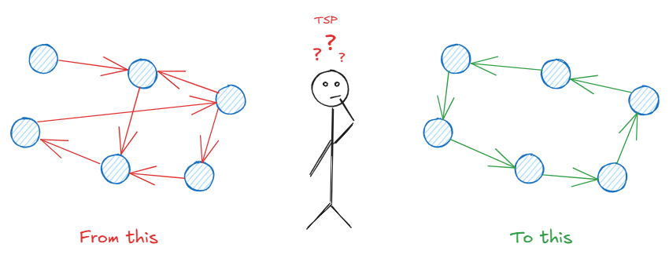
4
Mathematical Formulation of the TSP
Understanding the TSP Equation
Objective :
Given a list of cities and the distances between them, find the shortest possible route that :
Starts at a city
Visits every other city exactly once
Returns to the starting point
20

Slide 23
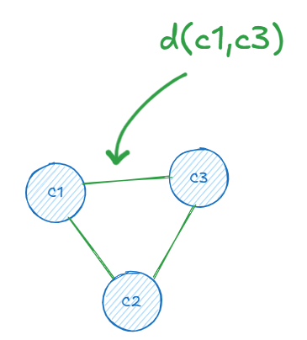
4
Mathematical Formulation of the TSP
The Ingredients
Let’s define the world of our problem :
Set of n cities C={1,2,...,n} A total of n cities to visit.
Distance Function d( i , j ) The cost or distance to go from city i to city j.
Tour/Path 𝜋 =[𝜋1,𝜋2,...,𝜋𝑛] The order in which we visit the cities , a permutation!
21

Slide 24
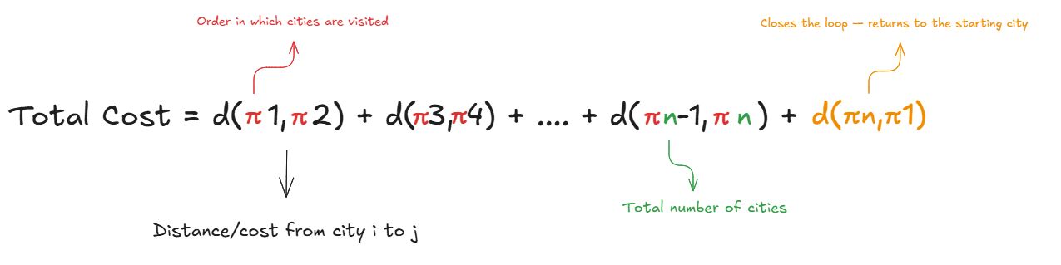
We will consider 4 cities in the Sahel region of Tunisia
4
Mathematical Formulation of the TSP
The Big Equation
Here’s how we calculate the total cost of a tour :
22

Slide 25
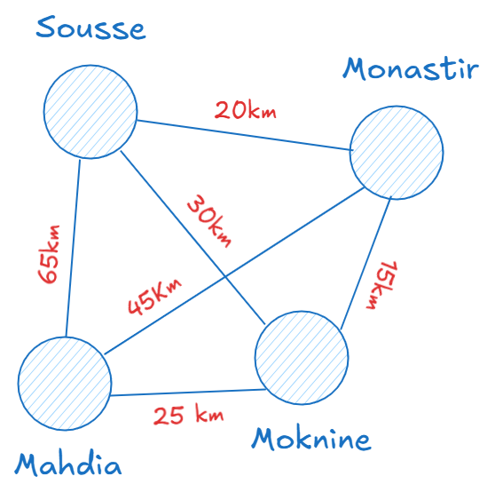
5
TSP Example – Touring the Sahel
Exemple Sahel Cities Tour
Cities in the Tour
We will consider 4 cities in the Sahel region of Tunisia
Question
Does a Hamiltonian Path or Circuit Exist ?
23
Notes:
✅ Hamiltonian Path? Yes! You can visit each city exactly once, in routes like: ➡️ Sousse → Moknine → Mahdia → Monastir ➡️ Monastir → Moknine → Sousse → Mahdia
✅ Hamiltonian Circuit? Yes! You can make a full tour starting and ending at the same city, like: 🔁 Sousse → Monastir → Moknine → Mahdia → Sousse 🔁 Mahdia → Moknine → Monastir → Sousse → Mahdia

Slide 26
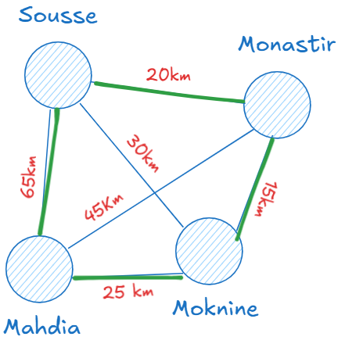
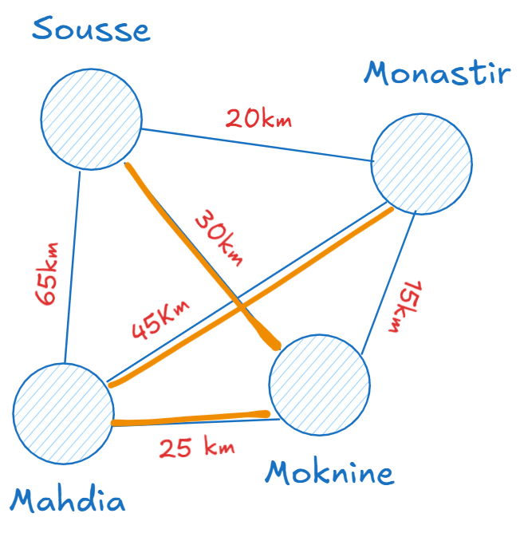
5
TSP Example – Touring the Sahel
Question answer
Hamiltonian Path
Hamiltonian Circuit
Yes! You can visit each city exactly once, in routes like
Yes! You can make a full tour starting and ending at the same city, like
24
Notes:
✅ Hamiltonian Path? Yes! You can visit each city exactly once, in routes like: ➡️ Sousse → Moknine → Mahdia → Monastir ➡️ Monastir → Moknine → Sousse → Mahdia
✅ Hamiltonian Circuit? Yes! You can make a full tour starting and ending at the same city, like: 🔁 Sousse → Monastir → Moknine → Mahdia → Sousse 🔁 Mahdia → Moknine → Monastir → Sousse → Mahdia

Slide 27
5
TSP Example – Touring the Sahel
Exemple Sahel Cities Tour
Distance Matrix (d(i, j) in km)
This matrix shows the direct distances between each pair of cities in the Sahel region.
From \ To | Sousse | Monastir | Mahdia | Moknine
Sousse | - | 20 | 65 | 30
Monastir | 20 | - | 45 | 15
Mahdia | 65 | 45 | - | 25
Moknine | 30 | 15 | 25 | -
25

Slide 28
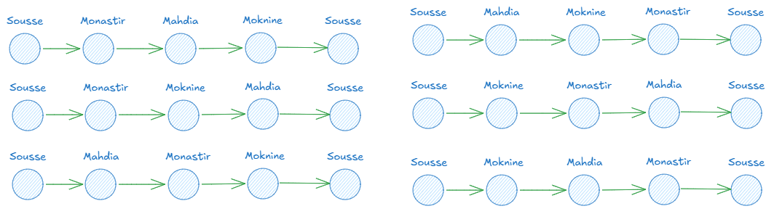
5
TSP Example – Touring the Sahel
Exemple Sahel Cities Tour
All Possible City Tours (Permutations)
Assuming we start at Sousse, the permutations of the other 3 cities are
26

Slide 29
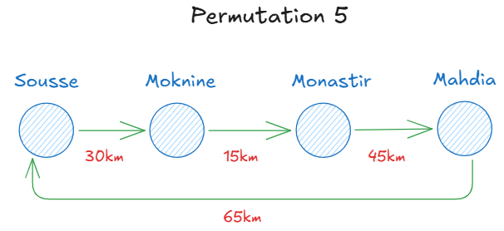
5
TSP Example – Touring the Sahel
Exemple Sahel Cities Tour
Step-by-Step Calculation Total Cost
We will calculate the total distance by following the edges
Total cost = 30 km + 15 km + 45 km + 65km = 155km
27

Slide 30
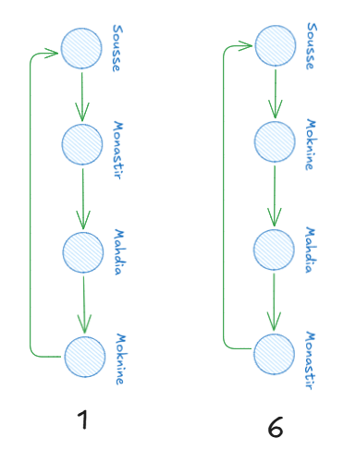
5
TSP Example – Touring the Sahel
Exemple Sahel Cities Tour
Step-by-Step Calculation Total Cost
The optimal route for the shortest distance
Results for Other Permutations
Permutation 1 = 120 km
Permutation 2 = 125 km
Permutation 3 = 155 km
Permutation 4 = 125 km
Permutation 5 = 155km
Permutation 6 = 120 km
28

Slide 31

6
Understanding Computational Complexity
The Beast Behind the Beauty
Complexity classes
To understand why TSP is Hard, we first need to explore key computational complexity classes and how TSP fits into them. This will help us classify and explain its complexity.
29
Notes:
In computer science, we classify problems based on how difficult they are to solve and how long it takes to find the solution. These classifications are called complexity classes.

Slide 32
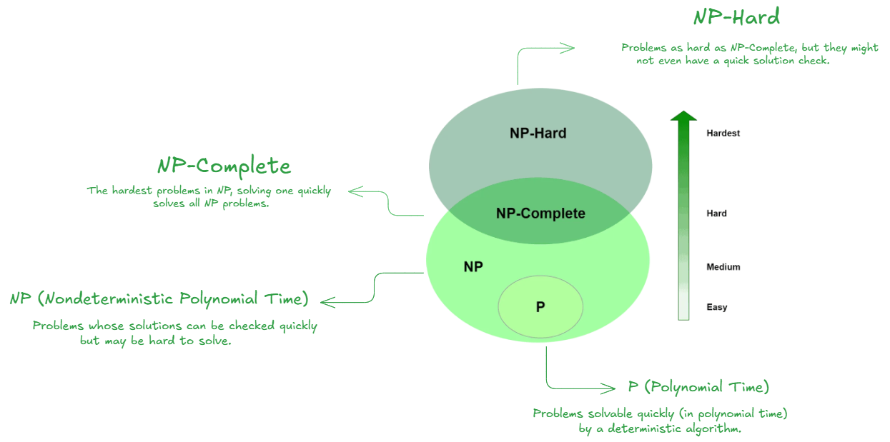
6
Understanding Computational Complexity
The Beast Behind the Beauty
Complexity classes
30

Slide 33
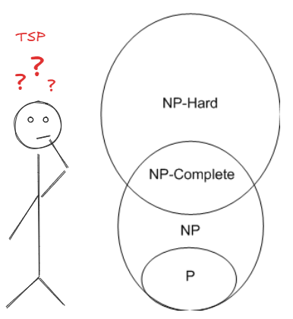
6
Can You Classify the TSP?
TSP complexity ?
Question
Now that we've explored the complexity classes P, NP, NP-Complete, and NP-Hard...Where does the Traveling Salesman Problem (TSP) fit in ?
31

Slide 34
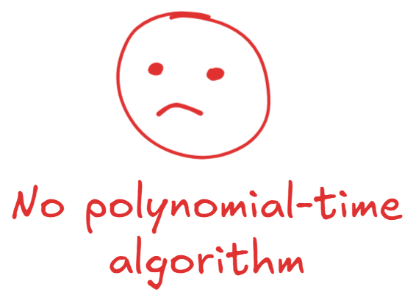

7
TSP is NP-Hard
Why ?
Why it's NP-Hard ?
No fast solution known (no polynomial-time algorithm)
we can’t just try all paths when cities grow it would take centuries!
Because the number of possible routes grows factorially with the number of cities
Not in NP-Complete
because it’s not a Yes/No decision problem
We’re not asking a Yes/No question we want the best path, not just any valid one
32
Notes:
(n-1)!
Anything that grows much faster than a polynomial — like:
Exponential: 2ⁿ
Factorial: n! → These grow super fast, and are not considered practical for big inputs.

Slide 35

7
TSP is NP-Hard
Why ?
Why it's NP-Hard ?
It’s as hard or harder than all problems in NP
You can't just check if a solution is valid quickly. You need to explore many possible routes to find the shortest one.
33
Notes:
After explaining the computational complexity classes and why the Traveling Salesman Problem (TSP) is NP-Hard, here are some suggested next slides to continue the presentation:

Slide 36

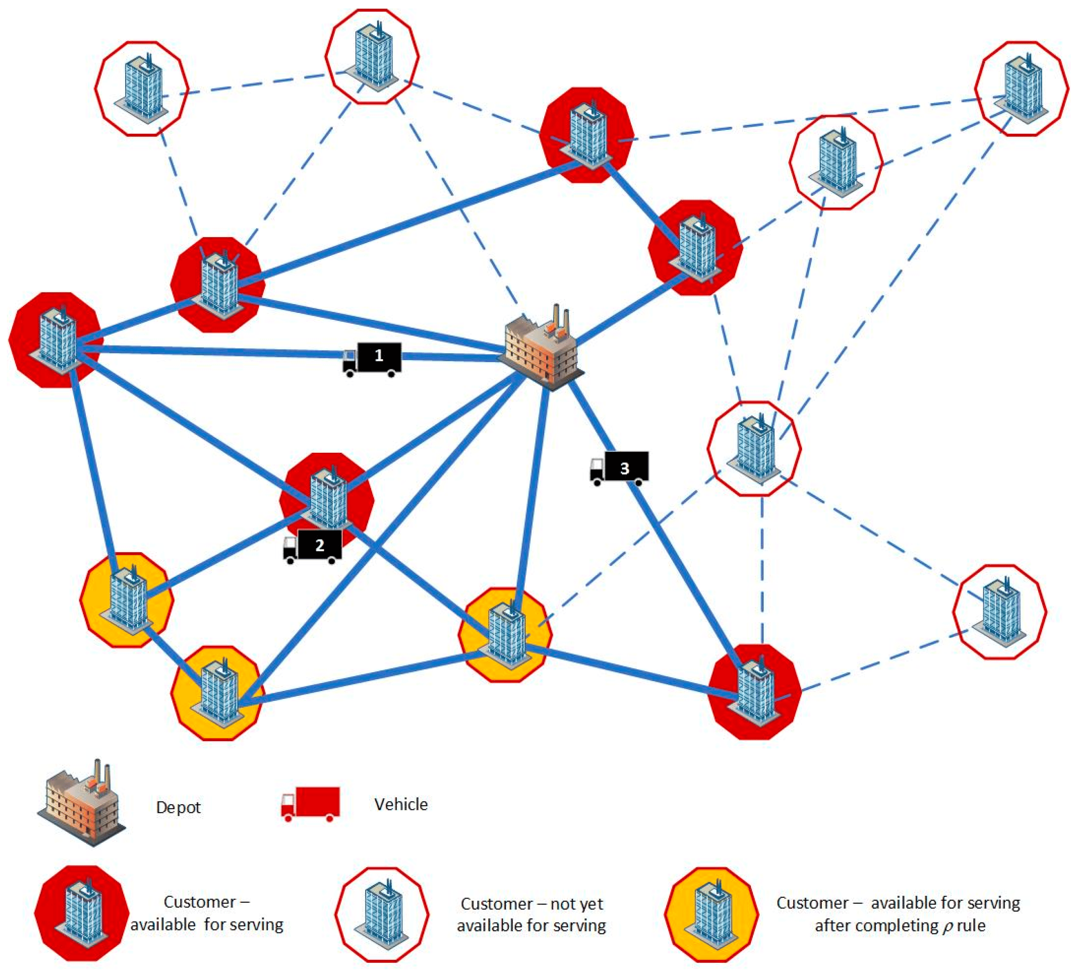
8
Real-World Applications of TSP
TSP
Applications of the Traveling Salesman Problem
Logistics and Delivery Routing
Circuit Board Design
How delivery companies optimize routes.
Minimizing the path in manufacturing processes.
34
Notes:
After explaining the computational complexity classes and why the Traveling Salesman Problem (TSP) is NP-Hard, here are some suggested next slides to continue the presentation:

Slide 37
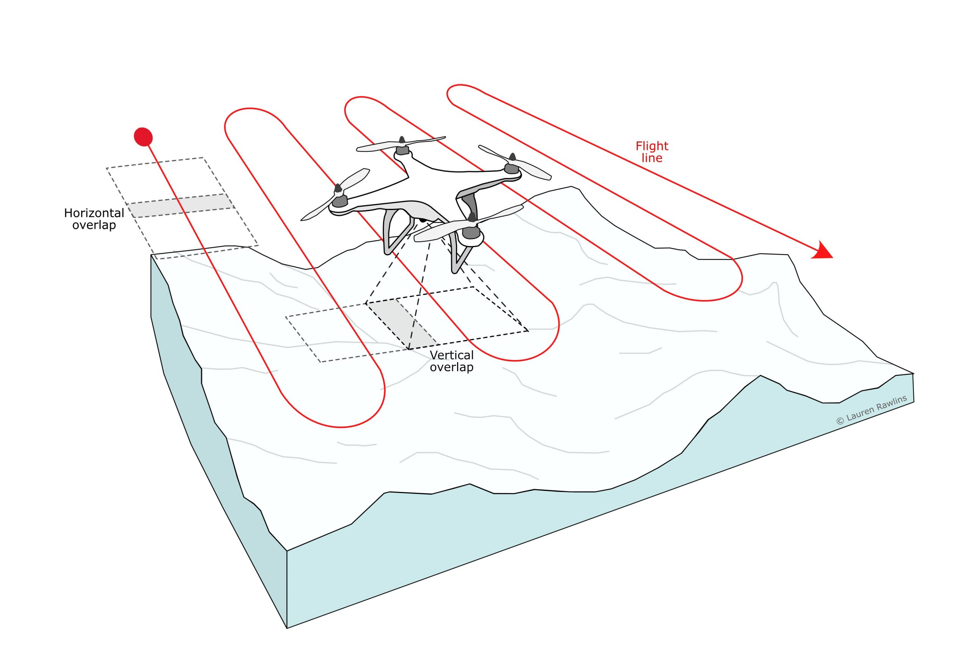
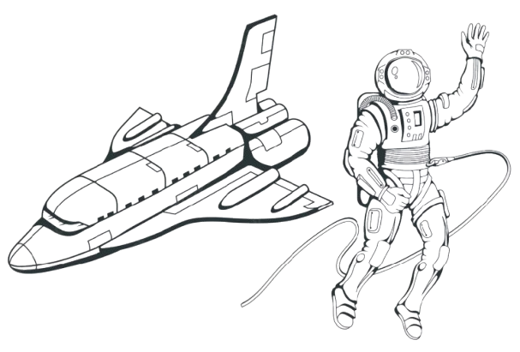
8
Real-World Applications of TSP
TSP
Applications of the Traveling Salesman Problem
Space Exploration
Military & Defense
Finds the shortest path to conserve battery and avoid hazards.
Coordinates drones to avoid overlap and finish 3x faster.
35
Notes:
After explaining the computational complexity classes and why the Traveling Salesman Problem (TSP) is NP-Hard, here are some suggested next slides to continue the presentation:

Slide 38
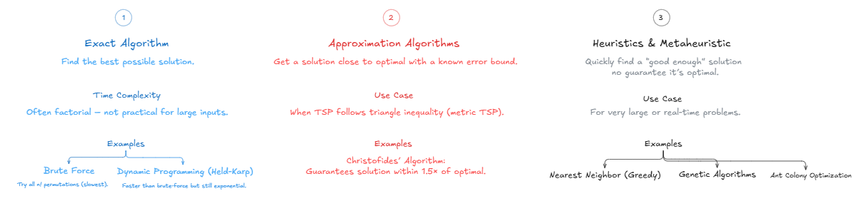
9
How Can We Solve the TSP?
Solve TSP
There are 3 main categories of methods used to tackle the Traveling Salesman Problem (TSP), each with its own trade-off between accuracy and speed
36
Notes:
After explaining the computational complexity classes and why the Traveling Salesman Problem (TSP) is NP-Hard, here are some suggested next slides to continue the presentation:

Slide 39

Brute Force Approach for TSP - Sahel Region Example
37

Slide 40
9
Brute Force Approach for TSP - Sahel Region Example
Analysis for Brute Force TSP
Code Overview
We generate all permutations of the cities and calculate the total distance for each permutation.
38
Notes:
After explaining the computational complexity classes and why the Traveling Salesman Problem (TSP) is NP-Hard, here are some suggested next slides to continue the presentation:

Slide 41
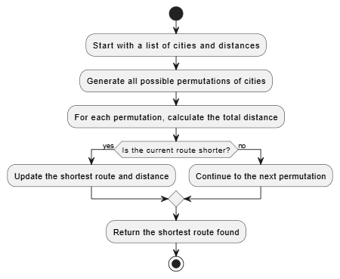
9
Brute Force Approach for TSP - Sahel Region Example
Analysis for Brute Force TSP
How It Works
39
Notes:
After explaining the computational complexity classes and why the Traveling Salesman Problem (TSP) is NP-Hard, here are some suggested next slides to continue the presentation:

Slide 42
9
Brute Force Approach for TSP - Sahel Region Example
Analysis for Brute Force TSP
Analysis of Time Complexity
Generating Permutations : The number of permutations for n cities in n! For 4 cities, the number of permutations is 4! = 24.
Calculating the Distance : For each permutation, calculating the total distance involves summing n distances. So, the time complexity for calculating the distance for each permutation is O(n) = O(4)
40
Notes:
After explaining the computational complexity classes and why the Traveling Salesman Problem (TSP) is NP-Hard, here are some suggested next slides to continue the presentation:

Slide 43
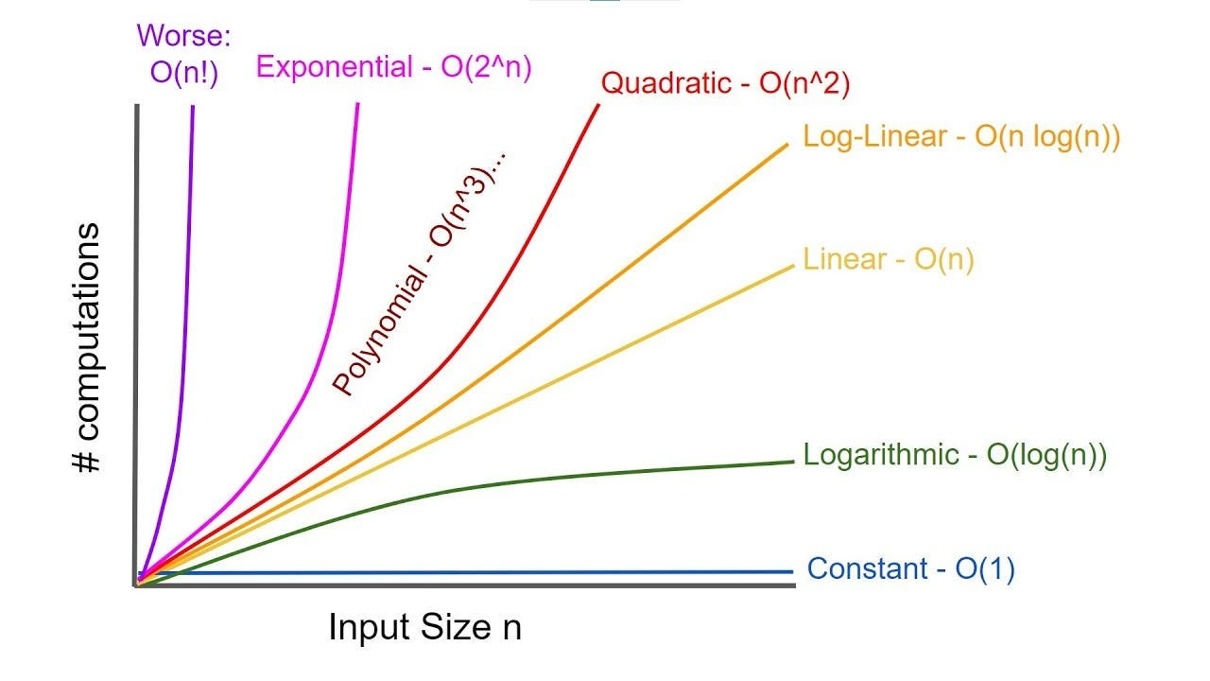
9
Brute Force Approach for TSP - Sahel Region Example
Analysis for Brute Force TSP
Analysis of Time Complexity
The total time complexity of this brute-force approach is O(n! * n) which grows factorially as n increases. For the current example ( n = 4 ) the computation is feasible, but for larger datasets (e.g., 10 cities), the number of permutations ( 10! = 3,628,800) becomes very large.
41
Notes:
After explaining the computational complexity classes and why the Traveling Salesman Problem (TSP) is NP-Hard, here are some suggested next slides to continue the presentation:

Slide 44
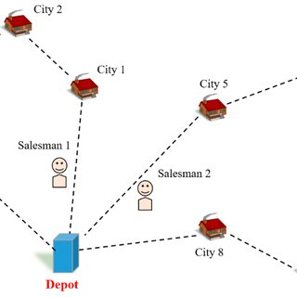
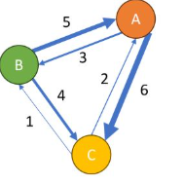
10
TSP Variants and Extensions
Exploring the Many Faces of the Problem
TSP Variants
SP isn’t just one problem there are several variations that add different twists
Asymmetric TSP (ATSP)
Multiple TSP (MTSP)
Distances between cities aren’t the same in both directions
More than one salesman, where each salesman starts from a different city.
42
Notes:
After explaining the computational complexity classes and why the Traveling Salesman Problem (TSP) is NP-Hard, here are some suggested next slides to continue the presentation:

Slide 45
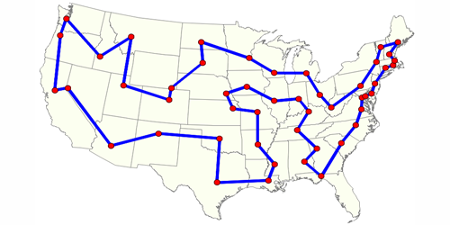
10
TSP Variants and Extensions
Exploring the Many Faces of the Problem
TSP Variants
SP isn’t just one problem there are several variations that add different twists
Bounded TSP
Limiting the number of cities to visit in the path.
43

Slide 46


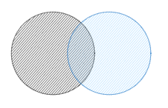
11
Future Directions and Challenges
Research Directions and Open Challenges
Research Directions and Open Challenges
let's explore where innovation is happening and what challenges still stand in the way TSP
Quantum Computing
Real-Time TSP Solutions
Hybrid Algorithms
Limiting the number of node to visit in the path.
Need for faster algorithms in real-time applications.
Exact algorithms with heuristics for better results.
44

Slide 47
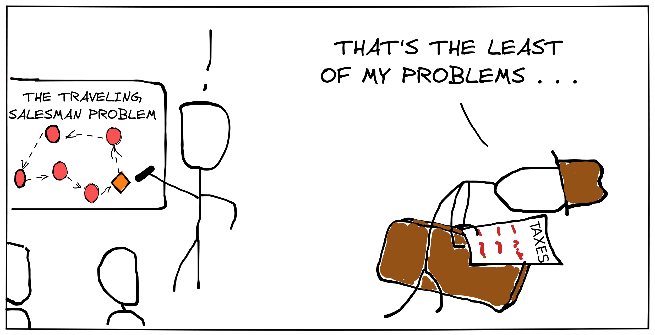
12
Conclusion
Conclusion TSP problem
The Traveling Salesman Problem is a classic challenge in optimization, with many variations and real-world applications. While solving it optimally is computationally intense, ongoing research is pushing boundaries with new algorithms and techniques
45

Slide 48

Thank You For Your attention !
Notes:
Merci pour votre attention toutes vos remarques et questions sont les bienvenues.

